Slide 1
Lesson 11: Performance-Based Compensation
Duration: 2 hours
Performance-Based Compensation
Slide 11- 1

Slide 2
Lesson 11 Topics
Lesson 11 Topics
Topic 1 – Pay Pools
Topic 2 – Eligibility for Performance-Based Payouts
Topic 3 – Forms of Performance-Based Payouts
Topic 4 –Payout Timeline
Topic 5 – From Performance Management to Performance-Based Payout Decisions
Note: Additional training on pay pools can be found at: http://dcips.dtic.mil/training.html
Performance-Based Compensation
Slide 11- 2

Slide 3
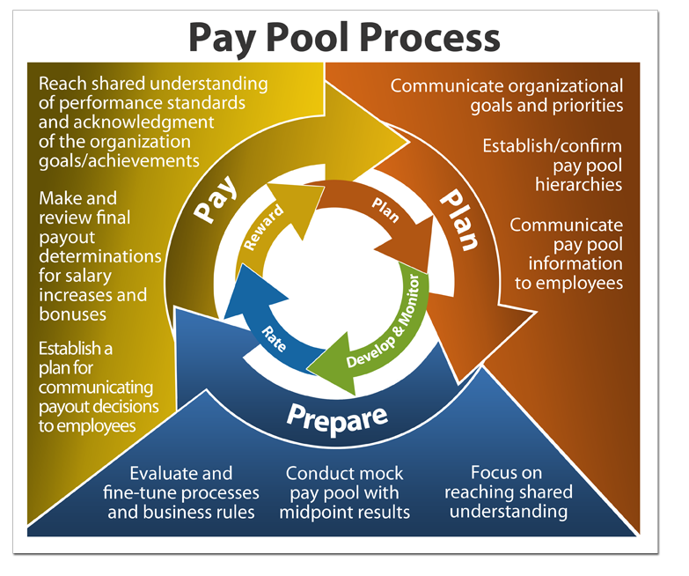
Pay Pool Process Overview
Performance Management Process
Performance-Based Compensation
Slide 11- 3

Slide 4
Pay Pools
Pay Pools
A “pay pool” is a group of employees with similar criteria (grade, band, supervisory status etc.), who share in one distribution of pay-for-performance dollars
Performance-Based Compensation
Slide 11- 4

Slide 5
Pay Pool Funding
Pay Pool Funding
The pay pool budget is set by September 30 of the performance year and is based on:
Historical spend trends
External budget guidance
Departmental budget guidance
Performance-Based Compensation
Slide 11- 5

Slide 6
Payout Eligibility
Payout Eligibility
Performance Evaluation of Record | General Pay Increase (in graded structure) | DCIPS “Floor” Increase (in banded structure) | Performance-Based Bonus (in both graded and banded structures) | Performance-Based Salary Increase (banded structure)
Outstanding Excellent Successful | Yes | Yes | Yes | Yes
Minimally Successful | Yes | Yes | No | No
Unacceptable | Yes | No | No | No
Performance-Based Compensation
Slide 11- 6

Slide 7
Performance-Based Payouts
Research your assigned performance-based payout
Performance-Based Salary Increases
Performance-Based Bonuses
Review the information in the WYSK boxes on pages 11-15_11-18
Make notes in the Participant Guide on page 11-19
You may be asked to share what you’ve learned with the class
Performance-Based Compensation
Slide 11- 7

Slide 8
Pay Pool Process Overview
Performance Management Process
Performance-Based Compensation
Slide 11- 8

Slide 9
Payout Timeline
October - Assess Performance
Employee writes self-report of accomplishments
November/December - Conduct Pay Pool Panel
Pay Pool panel develops recommendations for salary and/or bonus increases
January - Reward Performance
Performance-based payouts, generally effective first pay period in January
Rating Official assigns ratings and writes narrative(s)
Reviewing Official gives approval
PM PRA approval and final Performance Evaluation of Record shared with employee
PP PRA review and approval
Performance-Based Compensation
Slide 11- 9

Slide 10
Performance-Based Payouts Method
Performance-Based Payouts Method
An algorithm is embedded in the Compensation Work Bench (CWB) to provide initial recommendations for performance-based salary increases (for Components in the banded structure) and bonuses for all Defense Intelligence Components
Pay pools review CWB recommendations and make any necessary adjustments
Employees are advised of their performance-based salary increases and/or bonuses by their Rating Official following approval of results by the PP PRA and before the effective date of the payment(s)
Performance-Based Compensation
Slide 11- 10

Slide 11
Performance-Based Payout Decisions
Performance-Based Payout Decisions
“Performance payout” refers to the total compensation awarded as recognition for performance
Performance-Based Compensation
Slide 11- 11

Slide 12
Lesson 11 Review
Lesson 11 Review
Topic 1 – Pay Pools
Topic 2 – Eligibility for Performance-Based Payouts
Topic 3 – Forms of Performance-Based Payouts
Topic 4 – Payout Timeline
Topic 5 – From Performance Management to Performance-Based Payout Decisions
Slide 11- 12
Performance-Based Compensation
Slide 3- 2

